Slide 1

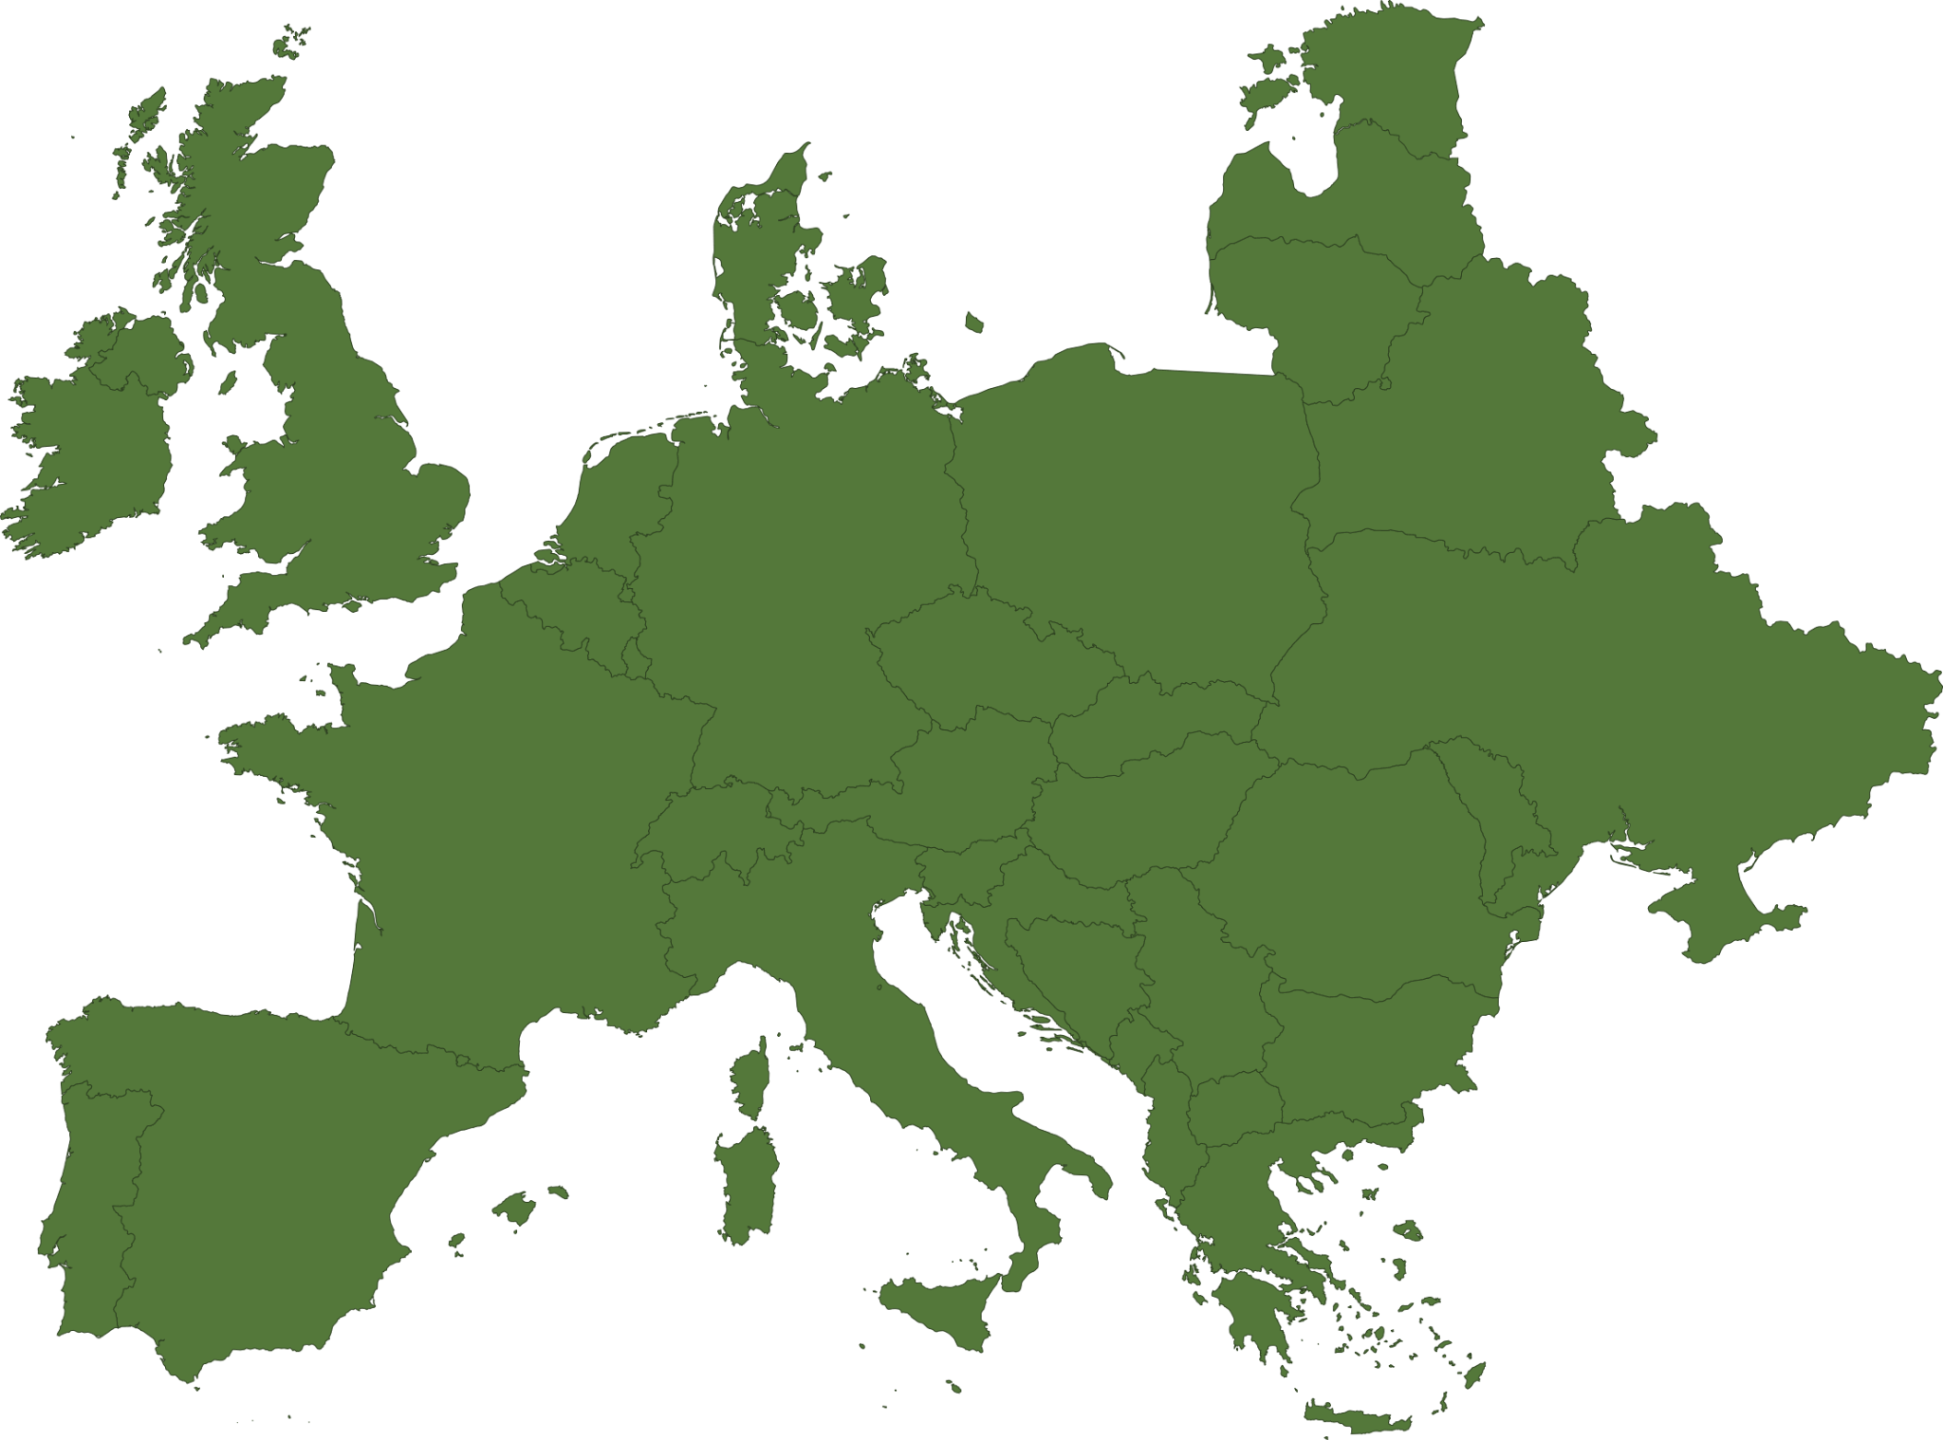
RESEARCH PROJECT
01 / 11
THE EU ELECTRICITY TRANSITION
How green is
Europe’s electricity?
Sixteen years of data. Twenty-seven countries. One changing energy mix.
Students: Pau Pedrejon · Clara Maltex · Mohammed Mahmoud
Scientific Visualization · UNIMI 2026-2027
SOURCE: OWID / EMBER

Slide 2
RESEARCH DESIGN
02 / 11
Three questions, one story.
We explore how the EU-27 electricity mix evolved from 2010 to 2025, and how it relates to carbon intensity.
01
02
03
HOW HAS EUROPE CHANGED?
HOW DO EU COUNTRIES DIFFER?
WHAT EXPLAINS CARBON INTENSITY?
Track the renewable, nuclear and fossil shares of EU electricity generation from 2010 to 2025.
Compare electricity portfolios and identify renewable-led, nuclear-led and fossil-heavy examples.
Test relationships using Spearman correlation: renewables alone versus renewables plus nuclear.

Slide 3
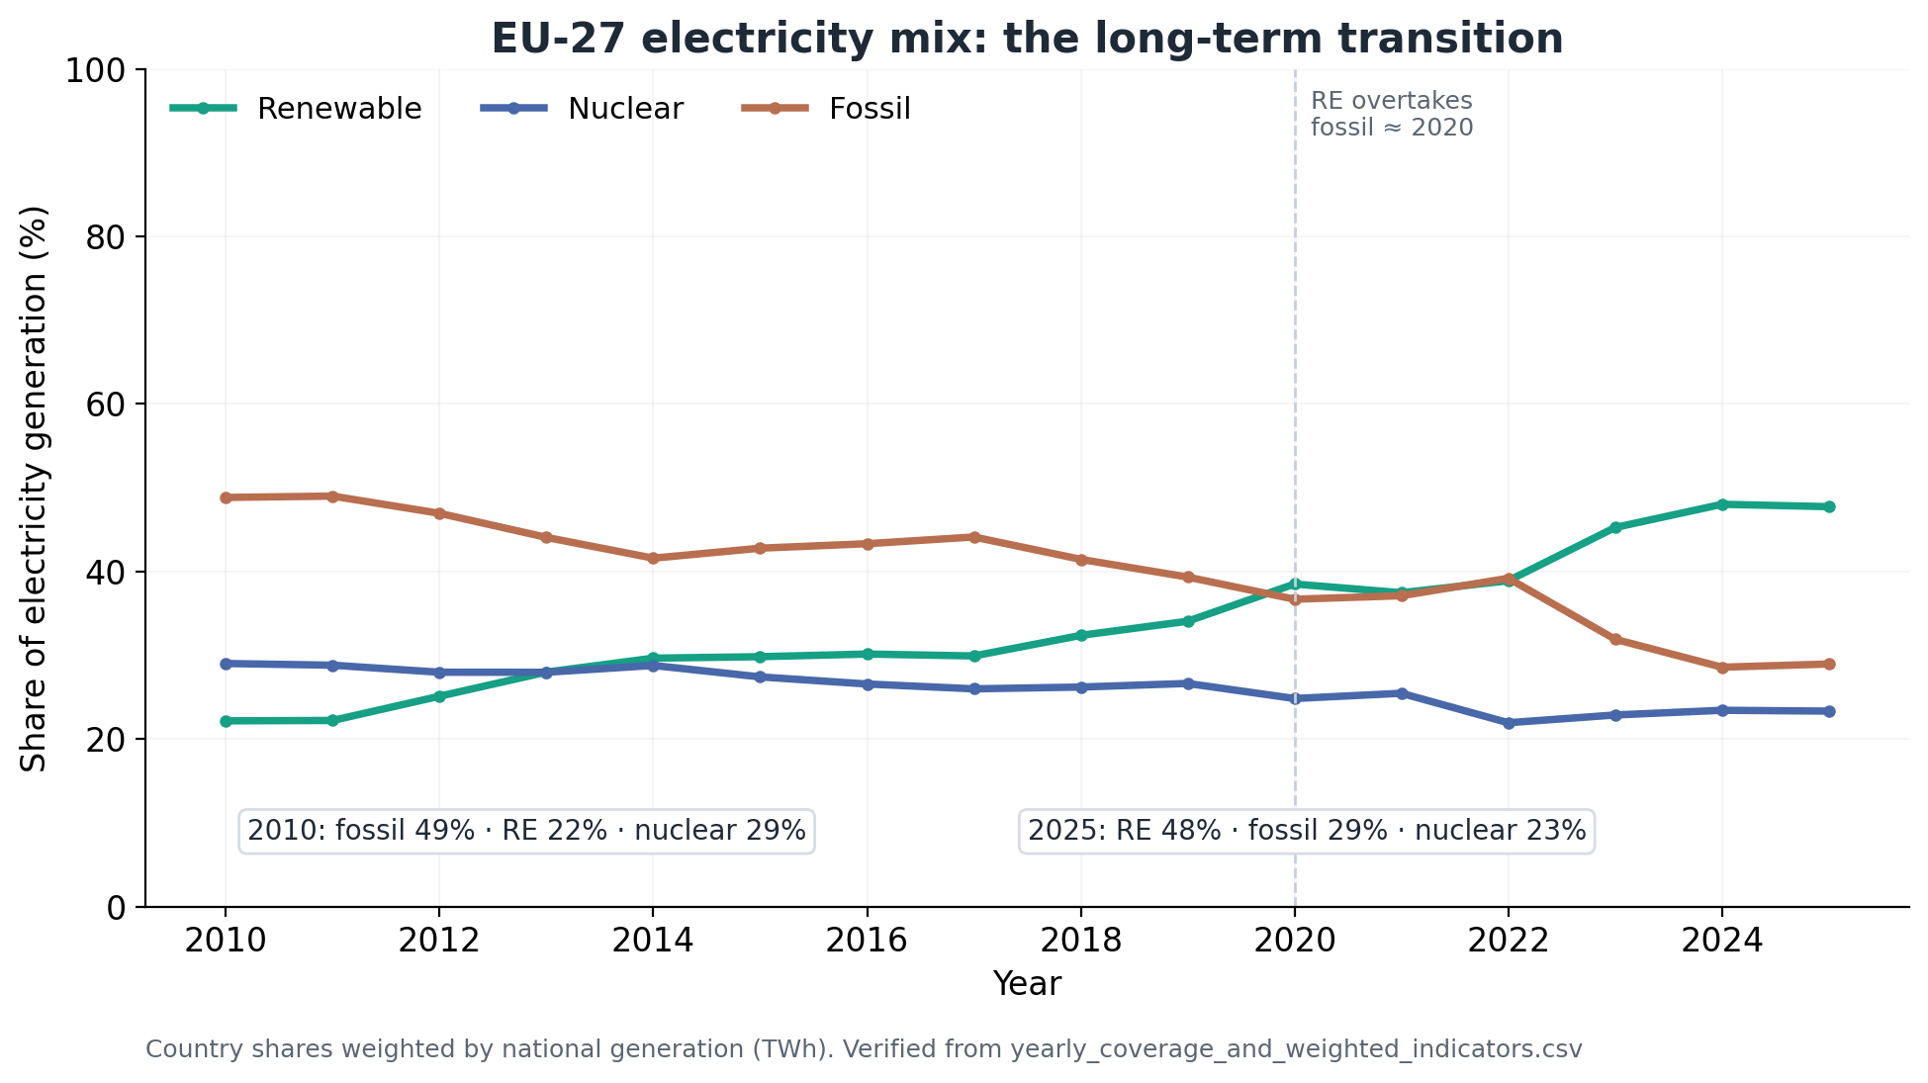
03 · DATA & EU MIX
03 / 11
Renewables doubled as fossil generation fell
EU-27 · 2010–2025 · 432 country-year observations
THE TAKEAWAY
Europe’s electricity mix changed substantially.
Renewables
22.2% → 47.7%
Fossil fuels
48.8% → 28.9%
Nuclear
29.0% → 23.3%
Generation-weighted EU shares
OWID Energy · no imputation
Notes:
Dataset: OWID Energy, pinned version 2026-09-10. Source: https://catalog.ourworldindata.org/garden/energy/2026-09-10/owid_energy/owid_energy.csv . Retained sample: the same current EU-27 countries for 2010–2025, 432 country-year observations. The generation, aggregate mix shares, and carbon-intensity indicators used for the trends are complete throughout this period; no values were imputed. EU aggregate shares are weighted by national electricity generation in TWh, rather than averaging country percentages equally. These are generation shares, not total energy consumption shares. Renewables first exceed fossil share in 2020, are slightly below fossil in 2022, and exceed it again from 2023. Renewable share in 2025 is slightly below 2024. The graph is the original project PNG with its original axes and annotations.

Slide 4
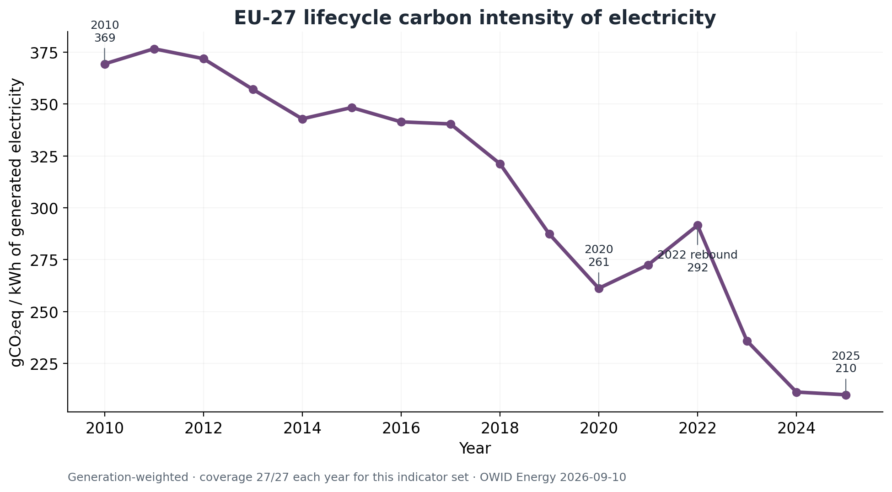
04 · CARBON INTENSITY
04 / 11
Electricity carbon intensity fell by 43%
Generation-weighted lifecycle emissions · EU-27 · 2010–2025
THE TAKEAWAY
The long-term decline remained clear.
369 → 210 gCO₂eq/kWh
2010 → 2025
−43% overall
2022 rebound: 292
Generation differs from consumption;
imports and exports matter.
Notes:
Dataset: OWID Energy, pinned version 2026-09-10. Source: https://catalog.ourworldindata.org/garden/energy/2026-09-10/owid_energy/owid_energy.csv . Carbon intensity measures lifecycle greenhouse gas emissions in gCO2-equivalent per kWh of generated electricity. EU values are generation-weighted. The local raw data reproduce 369.348 gCO2eq/kWh in 2010, 291.552 in 2022, and 209.897 in 2025: an overall decline of about 43.17%. This is an intensity reduction, not an estimate of the percentage change in total electricity emissions. The 2022 rebound accompanies a larger fossil share and a smaller nuclear share; this descriptive analysis does not establish the causal contributions of particular events. This is generation-based, and consumption footprints can differ because of electricity trade. Hand over to Clara: the EU average hides substantial differences between national electricity profiles. The graph is the original project PNG with its original axes and annotations.

Slide 5
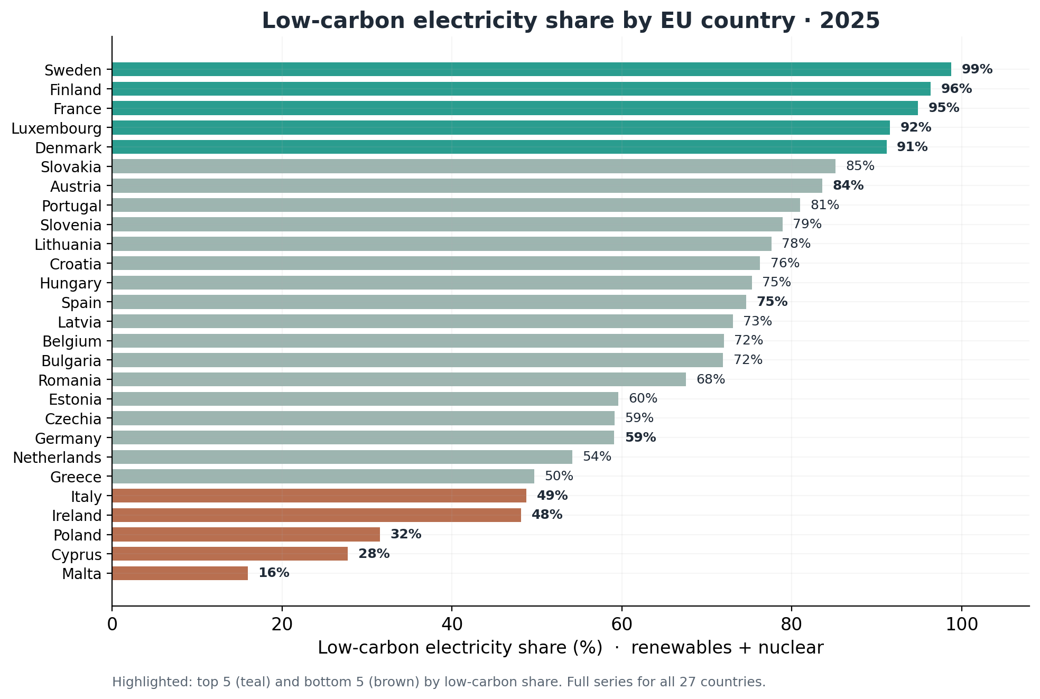
COUNTRY COMPARISON 1
05 / 11
Who leads in low-carbon electricity?
Share of electricity generation from renewables and nuclear · EU-27, 2025
THE TAKEAWAY
A highly uneven transition.
Low-carbon electricity ranges from 98.8% in Sweden to just 16.0% in Malta - a gap of 82.8 percentage points.

Slide 6
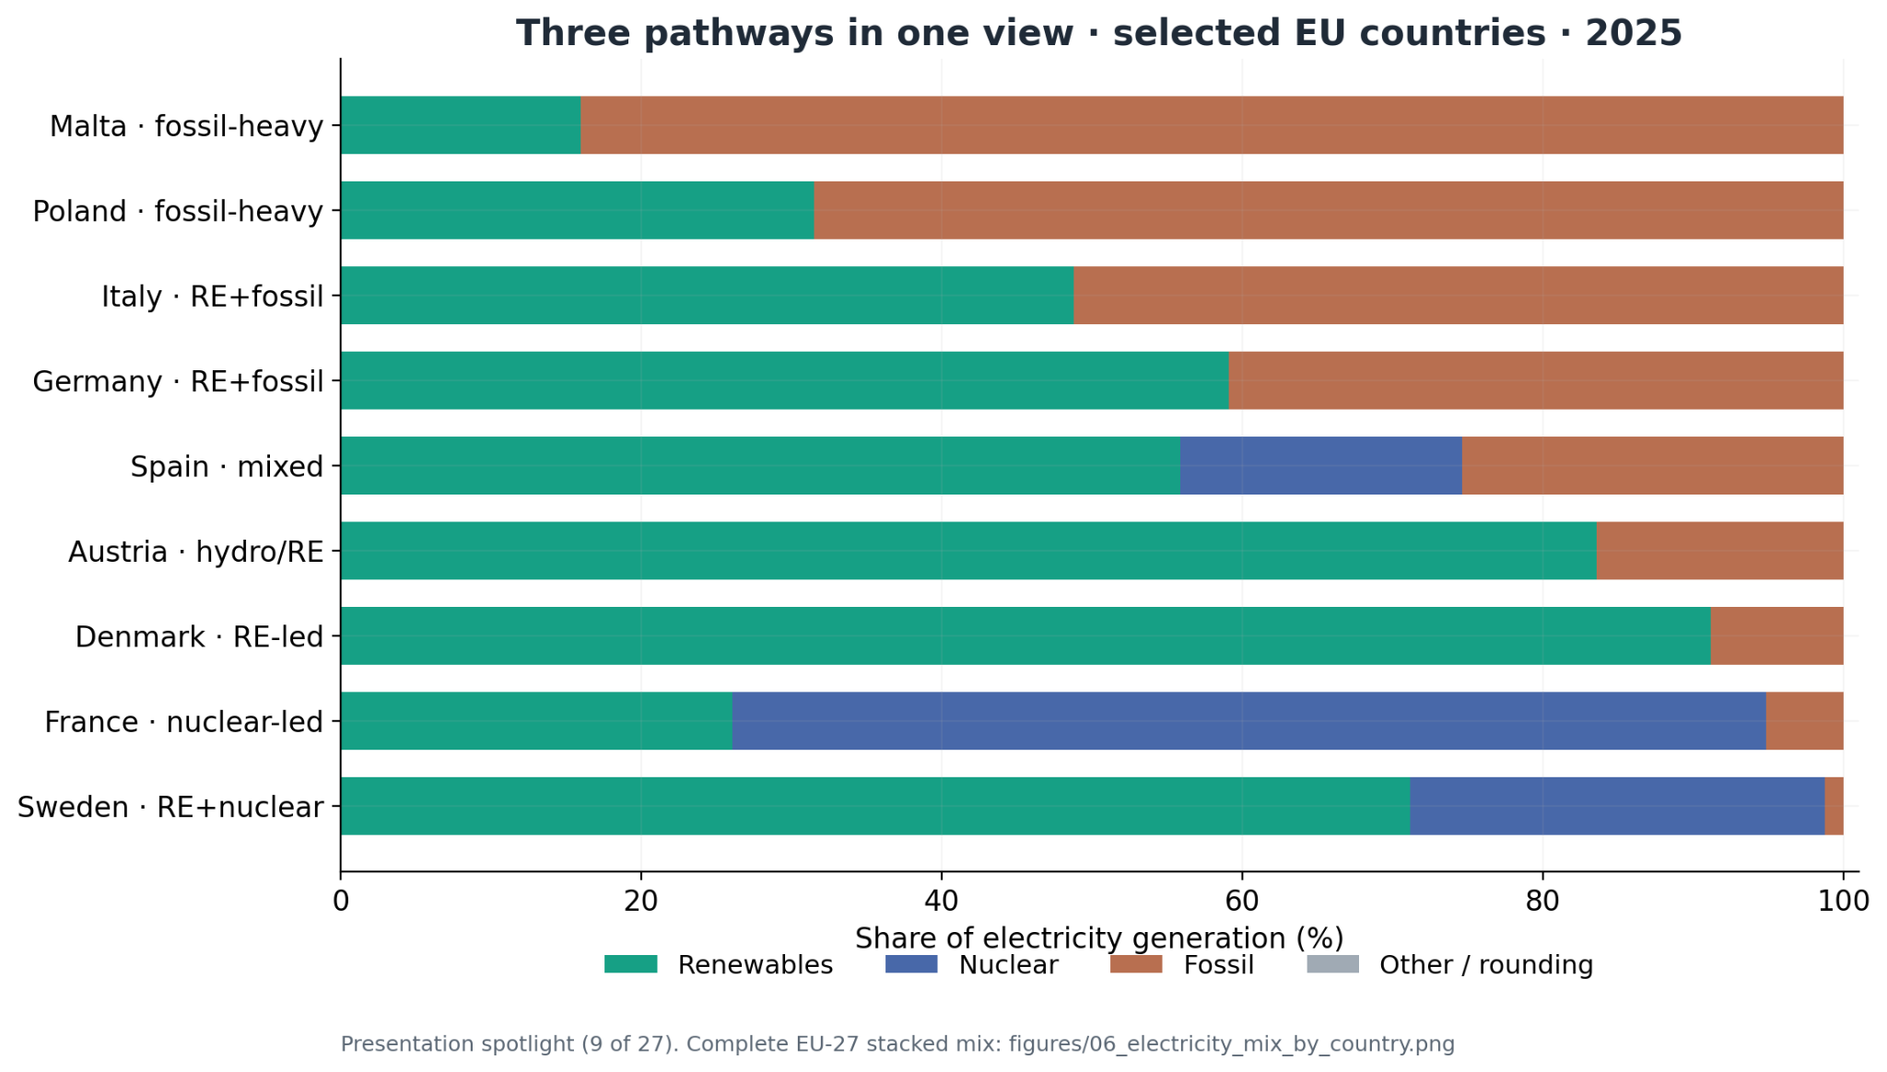
COUNTRY COMPARISON 2
06 / 11
Similar outcomes, different electricity mixes.
Renewable, nuclear and fossil shares of electricity generation · Selected EU countries, 2025
THE TAKEAWAY
Similar low-carbon shares, different energy sources.
Denmark relies on renewables, while France relies mainly on nuclear power. Both exceed 90% low-carbon electricity.

Slide 7
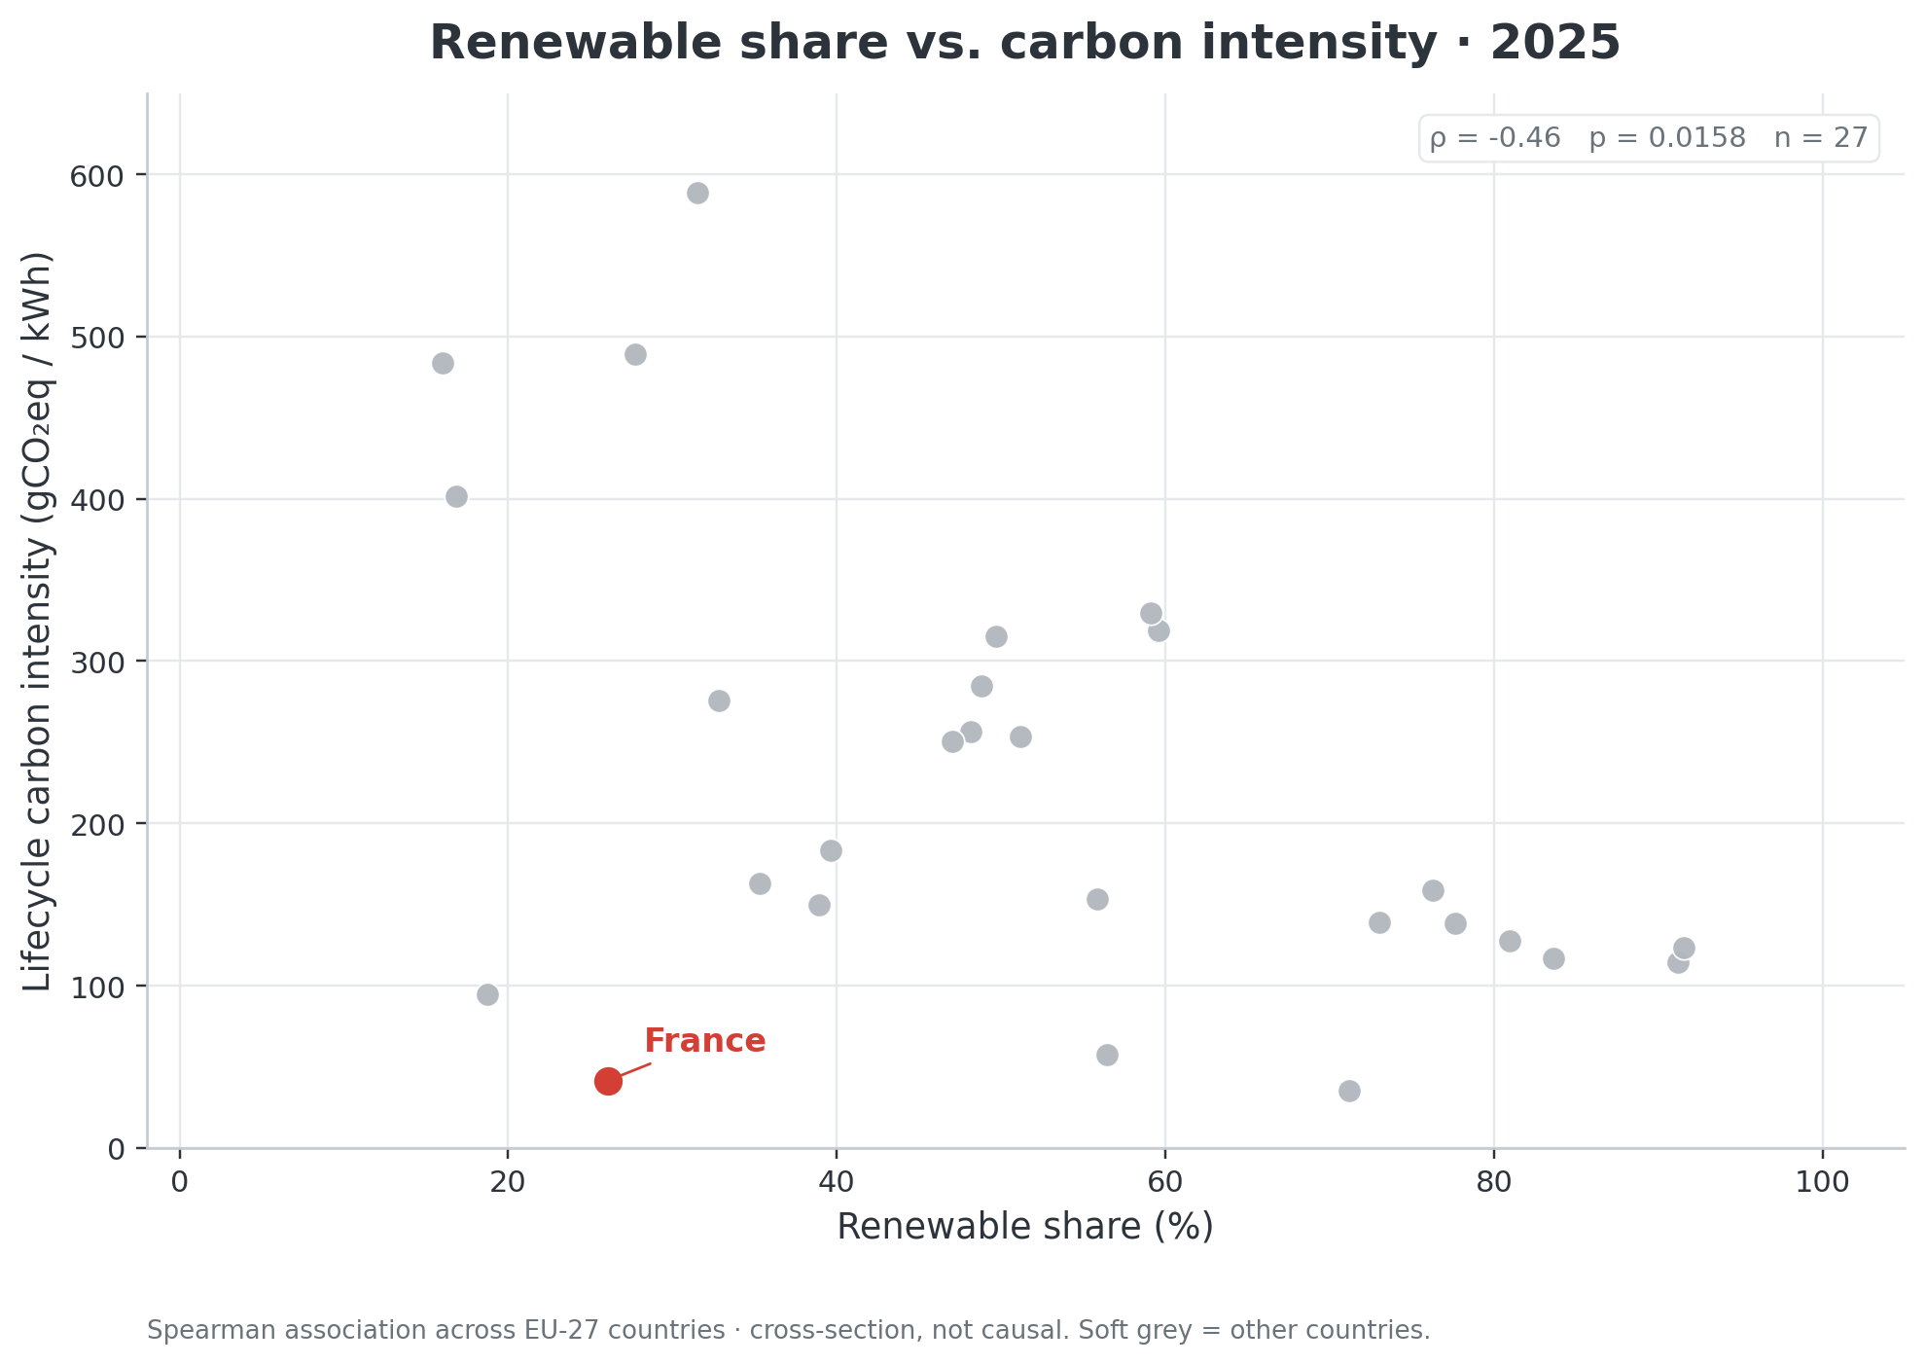

07 · CORRELATION 1
07 / 11
Are renewables alone enough?
Spearman association · renewable share vs. lifecycle intensity · 2025
THE TAKEAWAY
A moderate negative relationship.
Spearman ρ = −0.46
p = 0.0158 (n = 27).
Counterexample
Renewable share
Lifecycle carbon intensity

Slide 8
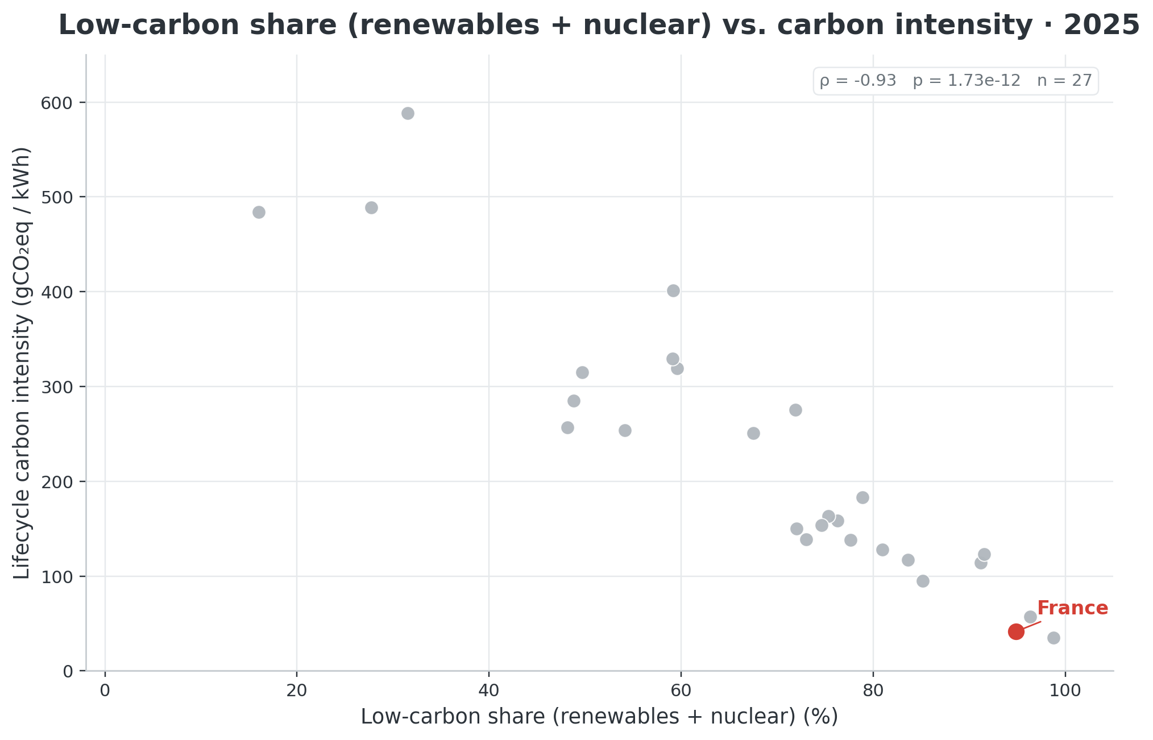
08 · CORRELATION 2
08 / 11
What changes when nuclear is included?
Spearman association · low-carbon share vs. lifecycle intensity · 2025
THE TAKEAWAY
The association becomes very strong.
Spearman ρ = −0.93
p ≈ 1.73 × 10⁻¹² (n = 27).
This is descriptive — not evidence of causation.

Slide 9
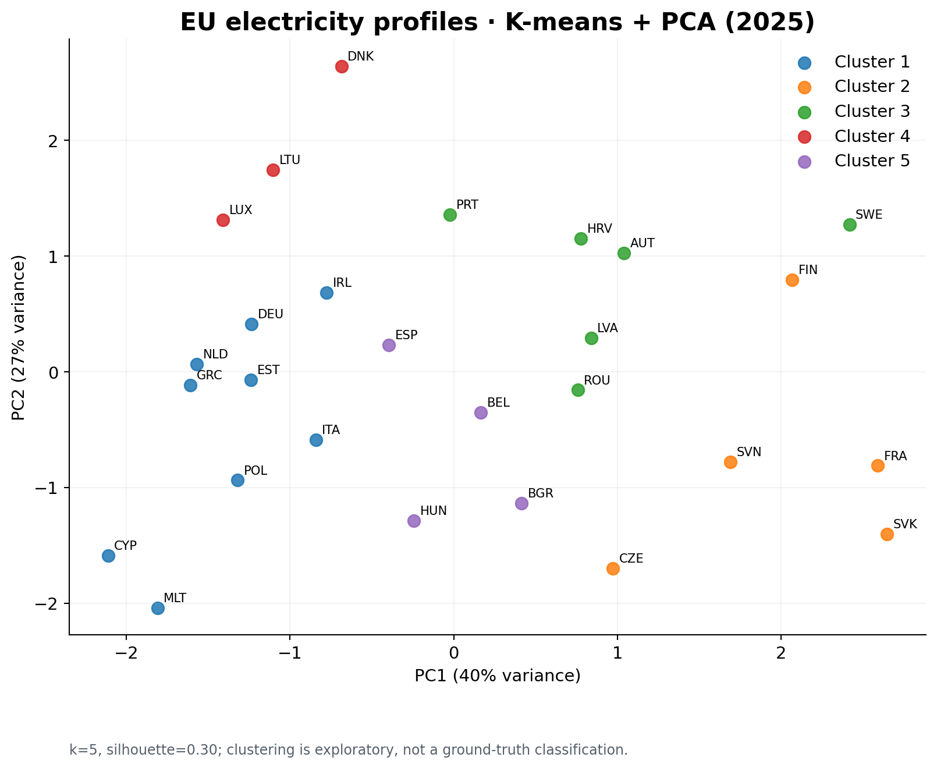
09 · EXPLORATORY
09 / 11
How can we visualize country similarities?
Five electricity sources · K-means groups · PCA projection · EU-27, 2025
THE TAKEAWAY
Five dimensions, two axes.
Each dot is a country.
Colors show K-means groups. PCA places them in 2D and retains 66.5% of the variance (PC1: 39.7%, PC2: 26.8%).
SOURCE: OWID / EMBER

Slide 10
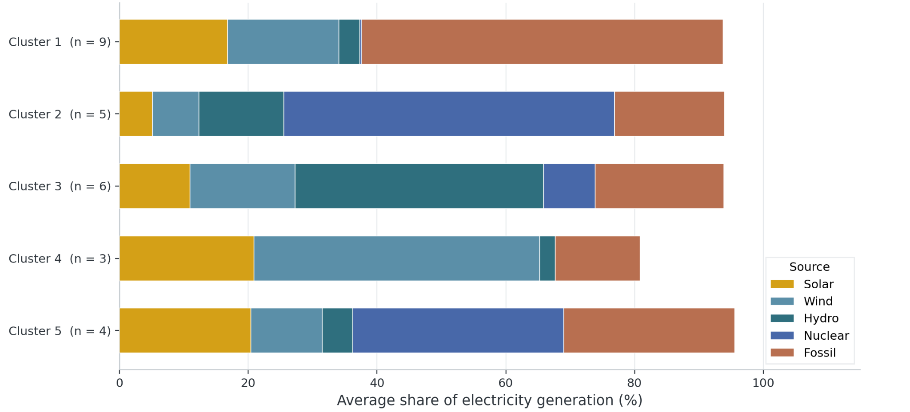
10 · EXPLORATORY
10 / 11
What patterns do the clusters reveal?
Average national solar, wind, hydro, nuclear and fossil electricity shares · 2025
THE TAKEAWAY
Different electricity mixes.
1 · Fossil-heavy (9)
2 · Nuclear-rich (5)
3 · Hydro-rich (6)
4 · Wind-rich (3)
5 · Mixed (4)
Silhouette ≈ 0.30: weak separation.
Mean country shares, not weighted by TWh. Other sources omitted; totals may be below 100%.
SOURCE: OWID / EMBER

Slide 11
CONCLUSIONS
11 / 11
One transition. Different pathways.
Three findings — plus the limitations that keep our claims responsible.
48%
−43%
−0.93
renewable share in 2025
carbon intensity
Spearman correlation
up from 22% in 2010
369 → 210 gCO2eq/kWh
low-carbon share vs. intensity
Descriptive correlations are not causal. Electricity generation differs from consumption. Clustering separation is weak.
LIMITATIONS

